Slide 1

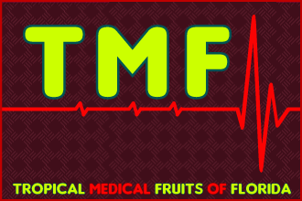
TMF Florida – Health Report
Vitamin and Mineral RDA’s:
“Recommended” or “Ridiculously-Low” Daily Allowances?
Website: www.TMFflorida.com Email: TropicalMedicalFruits@gmail.com Tel: (+1) 561-792-5925 Skype: TMF.FLORIDA (English – Deutsch – Español)

Slide 2
TMF Florida - Article
“Recommended Daily Allowances (RDA’s)
do little or nothing to prevent against our
epidemic of chronic degenerative diseases.”
- American Medical Association (AMA)
Website: www.TMFflorida.com Email: TropicalMedicalFruits@gmail.com Tel: (+1) 561-792-5925 Skype: TMF.FLORIDA (English – Deutsch – Español)

Slide 3
TMF Florida - Article
“70-80% of all diseases
in DEVELOPED COUNTRIES
are due to CLINICAL MALNUTRITION.”
- World Health Organization (W.H.O.)
Website: www.TMFflorida.com Email: TropicalMedicalFruits@gmail.com Tel: (+1) 561-792-5925 Skype: TMF.FLORIDA (English – Deutsch – Español)

Slide 4
World Health Organization – “Clinical Malnutrition”
TMF Florida - Article
Nutritional deficiencies are strongly related to, and considered by an ever-increasing number of modern medical doctors, researchers, health organizations and scientists, to be the primary underlying cause of innumerable chronic degenerative disease conditions (as well as, birth defects) which plague modern industrialized Western cultures.
Vast international scientific medical research support these facts (see research database - www.nutrionomics.com).
“70-80% of all diseases in DEVELOPED COUNTRIES ... are due to CLINICAL MALNUTRITION.” - World Health Organization (W.H.O.)
World Health Organization technical report series ; 916: “DIET, NUTRITION AND THE PREVENTION OFCHRONIC DISEASES” ... a report of a joint WHO/FAO expert consultation, Geneva, 28 January -- 1 February 2002. (WHO):
1.Chronic disease -epidemiology 2.Diet – standards 3.Feeding behavior
4.Energy metabolism 5.Motor activity 6.Cost of illness
More info: www.nutrionomics.com/Article%20-%20WHO/WHO_Chronic_Disease.pdf
Due to nutritional deficiencies … the deteriorating health of the average U.S. and European citizen will continue to reduce overall quality of life, restrict daily exercise and leisure activities, decrease work productivity and performance ... placing an enormous (and ever-increasing) burden upon national healthcare systems, in addition to the subsequent economic burdens upon Governments throughout the United States and EU.
Website: www.TMFflorida.com Email: TropicalMedicalFruits@gmail.com Tel: (+1) 561-792-5925 Skype: TMF.FLORIDA (English – Deutsch – Español)

Slide 5
TMF Florida - Article
American Medical Association (AMA)
RDA’s
(Recommended Daily Allowance)
Website: www.TMFflorida.com Email: TropicalMedicalFruits@gmail.com Tel: (+1) 561-792-5925 Skype: TMF.FLORIDA (English – Deutsch – Español)

Slide 6
American Medical Association (AMA) – “Speaks Out”
TMF Florida - Article
RDA’s were first introduced in the 1930’s, with minor changes later, for the purpose of reducing the incidences of scurvy, rickets, and pellagra in society which were known to be caused by nutritional deficiencies … and they did a good job of reducing these conditions throughout Western cultures.
Today, however, RDA’s are a confusing and misleading standard, causing many people to think that if they receive the RDA levels of certain vitamins and minerals, they're doing all that's recommended. This is clearly false and damaging to a confused and suffering population.
As noted in the American Medical Association (AMA) ”Speaks Out” page - www.mreassociates.org/pages/ama_speaks_out.html:
“Recommended Daily Allowances (RDA’s) do little or nothing to prevent against our epidemic of chronic degenerative diseases.” – AMA
Today, we live in a sea of pollution. Air pollution, contaminated sources of water, radiation, over-processed foods stripped of nutrients and with toxic additives, soils that are depleted of nutrients and their critical trace elements, countless new toxic chemicals overwhelming society every month, and more and more prescriptive drugs (many proving more harmful then their marketed benefits).
Couple these factors with less than adequate lifestyles and growing levels of psychological and physical stress, and you can see why the American Medical Association (AMA) report recommends increased vitamin and mineral intake for virtually everyone.
Source: www.mreassociates.org/pages/rda.html
Website: www.TMFflorida.com Email: TropicalMedicalFruits@gmail.com Tel: (+1) 561-792-5925 Skype: TMF.FLORIDA (English – Deutsch – Español)

Slide 7
Journal of American Medical Association (JAMA) - Report
TMF Florida - Article
American Medical Association Acknowledges the Role of Vitamins for Chronic Disease Prevention in Adults:
The Journal of the American Medical Association (JAMA) recently reversed a long-standing anti-vitamin stance by publishing two scientific review articles recommending multi-vitamin supplements for all adults.
The significance of this change is reflected in the historically conservative position of the American Medical Association (AMA) and other respected health organizations that been hesitant to routinely recommend vitamin supplements, except during pregnancy or to treat specific nutritional deficiencies.
Robert H. Fletcher, MD, MSc, and Kathleen M. Fairfield, MD, DrPH, of Harvard Medical School and the Harvard School of Public Health, reviewed more than 30+ years of scientific papers regarding vitamins in relation to chronic diseases and published their findings in two companion articles:
“Recent evidence has shown that sub-optimal levels of vitamins, even well above those causing deficiency syndromes, are associated with increased risk of chronic diseases including cardiovascular disease, cancer and osteoporosis."
In a clinical commentary, they note that “a large proportion of the general population” has less-than-optimal intakes of a number of vitamins, exposing them to increased disease risk. In addition, they counsel that, "it appears prudent for all adults to take vitamin supplements.”
Source: www.mreassociates.org/pages/ama_speaks_out.html
Website: www.TMFflorida.com Email: TropicalMedicalFruits@gmail.com Tel: (+1) 561-792-5925 Skype: TMF.FLORIDA (English – Deutsch – Español)

Slide 8
Journal of American Medical Association (JAMA) - Report
TMF Florida - Article
From the body of evidence they reviewed, they concluded the following:
Folate and Vitamins B6 and Vitamin B12 are required for homocysteine metabolism and are associated with decreased coronary heart disease risk.
Folate may decrease the risk of neural tube defects and certain cancers such as colorectal and breast cancers.
Vitamin E and lycopene may decrease the risk of prostate cancer.
Vtamin D is associated with decreased occurrence of fractures when taken with calcium.
Source: http://www.mreassociates.org/pages/ama_speaks_out.html
Website: www.TMFflorida.com Email: TropicalMedicalFruits@gmail.com Tel: (+1) 561-792-5925 Skype: TMF.FLORIDA (English – Deutsch – Español)

Slide 9
TMF Florida - Article
“Let food be thy medicine ...
and medicine be thy food“
- Hippocrates, 460–377 BC
Website: www.TMFflorida.com Email: TropicalMedicalFruits@gmail.com Tel: (+1) 561-792-5925 Skype: TMF.FLORIDA (English – Deutsch – Español)

Slide 10
TMF Florida - Article
Vitamin & Mineral
RDA
(Recommended Daily Allowance)
Website: www.TMFflorida.com Email: TropicalMedicalFruits@gmail.com Tel: (+1) 561-792-5925 Skype: TMF.FLORIDA (English – Deutsch – Español)

Slide 11
RDA’s – Australia & New Zealand Government Studies
TMF Florida - Article
“There is some evidence that a range of nutrients could have benefits in chronic disease aetiology at levels above the RDI. This is discussed in detail in the publications of the Food and Nutrition Board: Institute of Medicine as part of the reviews of the US:Canadian DRI’s, notably those published in 1998, 2000 and 2002.
The nutrients for which higher than RDI intakes have been linked to benefits for chronic disease risk include the antioxidant vitamins such as vitamin C, vitamin E and vitamin A (primarily its precursor, ß-carotene) as well as selenium and nutrients such as folate, omega 3 fats and dietary fibre.
These nutrients have been assessed in relation to heart disease and cancer … degenerative eye diseases such as cataract formation or macular degeneration … and conditions like Alzheimer's or cognitive decline.
The Nutrient Reference Values (NRVs) was a joint initiative of the …
Australian National Health and Medical Research Council (NHMRC) and the New Zealand Ministry of Health (MoH)
Source: www.nrv.gov.au/disease/introduction.htm
Website: www.TMFflorida.com Email: TropicalMedicalFruits@gmail.com Tel: (+1) 561-792-5925 Skype: TMF.FLORIDA (English – Deutsch – Español)

Slide 12
TMF Florida - Article
“One quick word about the so-called Recommended Daily Allowances:
Nonsense!
I believe they're just too low. These daily allowances, until recently, where called "Minimum Daily Requirements."
But then someone with a good sense of public relations realized that most people want more than just the "minimum."
So they changed "Minimum" to "Recommended" - but still left the amount at approximately the same low levels.”
- Dr. Dharma Singh Khalsa
Website: www.TMFflorida.com Email: TropicalMedicalFruits@gmail.com Tel: (+1) 561-792-5925 Skype: TMF.FLORIDA (English – Deutsch – Español)

Slide 13
RDA = “Ridiculous Daily Allowance” – by Hickey & Robert
TMF Florida - Article
“Many people consuming RDA levels of vitamins are likely to suffer from deficiency disease and premature death. Current official recommendations for nutrient intakes are inappropriate.
As this book demonstrates, the recommended dietary intake for vitamin C owes more to politics and prejudice than to science. Furthermore, the research behind the RDA values for vitamin C is biased and insubstantial.
This book presents an open challenge to the government "experts", who support the out-of-date RDA approach to nutrition and thereby endanger the health of the entire population. For people who value the peer review process, this book was read by thousands, including doctors and scientists.
The readers reported no significant scientific errors. The authors therefore assert that the RDA and the Codex justification for low intakes of vitamin C are both invalid and indefensible.”
RDA - Ridiculous Dietary Allowance (Paperback) - by Steve Hickey (Author) , Hilary Roberts (Author)
Source: www.lulu.com/spotlight/ascorbate
Website: www.TMFflorida.com Email: TropicalMedicalFruits@gmail.com Tel: (+1) 561-792-5925 Skype: TMF.FLORIDA (English – Deutsch – Español)

Slide 14
TMF Florida - Article
Vitamin C
RDA
(Recommended Daily Allowance)
Website: www.TMFflorida.com Email: TropicalMedicalFruits@gmail.com Tel: (+1) 561-792-5925 Skype: TMF.FLORIDA (English – Deutsch – Español)

Slide 15
Vitamin C … in Humans vs Nature
TMF Florida - Article
According to the U.S Government, the FDA and its medical and scientific advisors (and repeated by their European equivalents) … they recommend the average human being to take 60-95 mg of Vitamin C daily.
Let’s put that into perspective …
For example, by comparing an average human weighing 140lbs versus a mammal of similar size:
“A 140lb goat will produce about 13,000 mg (13 grams) of vitamin C every day. That's enough to keep him healthy in most circumstances. But if he's wounded or suffers a massive infection, the goat -- and virtually all other wild animals -- can synthesize as much as 100,000 additional mgs (100 grams) of vitamin C to get him through the crisis. Humans cannot do that.
Humans are one of the few animals that cannot produce vitamin C. Most other animals can. Since few of us take 13,000 mg a day of oral vitamin C, we get sick in staggering numbers.”
Source: http://owen.curezone.com/nutrition/benefitsofc.html
Website: www.TMFflorida.com Email: TropicalMedicalFruits@gmail.com Tel: (+1) 561-792-5925 Skype: TMF.FLORIDA (English – Deutsch – Español)

Slide 16
US Vitamin C Foundation’s Recommended Daily Allowance
TMF Florida - Article
RDA: 3,000 mg Vitamin C … 1000 mg three times per day
The Vitamin C Foundation recommends that every man, woman and child
over the age of 3 consume at least 3 g (3,000 mg) vitamin C daily
in order to enjoy optimum health.
More during pregnancy (6,000 – 9,000 mg) …
and much more during periods of disease (20,000 to 300,000 mg).
Source: http://www.vitamincfoundation.org/vitcrda.shtml
Website: www.TMFflorida.com Email: TropicalMedicalFruits@gmail.com Tel: (+1) 561-792-5925 Skype: TMF.FLORIDA (English – Deutsch – Español)

Slide 17
RDA Chart - A Comparison of Vitamin C “Experts”
TMF Florida - Article
RDI / RDA | Source / Population
60-95 mg | U.S. Government / FDA Recommended Intake
200 mg | Levin / NIH Recommendation
400 mg (recently increased) | Linus Pauling Institute Recommendation
2500 mg | Hickey / Roberts Minimum
3000 mg | Vit C Foundation’s Daily Recommendation
6000 - 12,000 mg | Levy’s Daily Recommendation
6000 - 18,000 mg | Linus Pauling’s Daily Recommendation
6000 - 9000 mg | Pregnancy
6000 - 18,000 mg | Heart Disease
14,000 - 30,000 mg | Cancer
20,000 – 300,000 mg | Cathcart / Levy Cure for Infectious Diseases
Source: http://www.vitamincfoundation.org/vitcrda.shtml
Website: www.TMFflorida.com Email: TropicalMedicalFruits@gmail.com Tel: (+1) 561-792-5925 Skype: TMF.FLORIDA (English – Deutsch – Español)

Slide 18
TMF Florida - Article
Vitamin C Research
Website: www.TMFflorida.com Email: TropicalMedicalFruits@gmail.com Tel: (+1) 561-792-5925 Skype: TMF.FLORIDA (English – Deutsch – Español)

Slide 19
Part 1 - Vitamin C Medical Studies Research – by Dr. Levy
TMF Florida - Article
Dr. Levy exhaustively researched the existing medical literature on vitamin C for the last 70 years. Here's a short list of illnesses which doctors have CURED or PREVENTED using mega-doses of vitamin C through drip-needles.
(1) Acute Hepatitis | (7) Viral Pneumonia
(2) Polio | (8) Streptococcal infections
(3) Measles | (9) Dysentery
(4) Mumps | (10) Diptheria
(5) Chicken Pox | (11) Influenza
(6) Herpes
Medical Book: VITAMIN C, INFECTIOUS DISEASES, AND TOXINS – by Dr. Thomas Levy
Source: www.owen.curezone.com/nutrition/benefitsofc.html
Website: www.TMFflorida.com Email: TropicalMedicalFruits@gmail.com Tel: (+1) 561-792-5925 Skype: TMF.FLORIDA (English – Deutsch – Español)

Slide 20
Part 1 - Vitamin C Medical Studies Research – by Dr. Levy
TMF Florida - Article
Another list of medical horrors Dr. Levy says are REVERSIBLE and PREVENTABLE with high-dose Vitamin C:
(1) HIV | (3) Typhoid Fever
(2) Tuberculosis | (4) Leprosy
Dr. Levy adds that "both Lupus and MS respond well to high-dose vitamin C therapy." (p.404).
Vitamin C has also been used successfully to treat the following poisonings:
(1) Carbon Monoxide | (5) Radiation
(2) Alcohol | (6) All Heavy Metals
(3) Barbiturates | (7) Mushrooms
(4) Pesticides | (8) Snake & Spider Venom
Medical Book: VITAMIN C, INFECTIOUS DISEASES, AND TOXINS – by Dr. Thomas Levy
Website: www.TMFflorida.com Email: TropicalMedicalFruits@gmail.com Tel: (+1) 561-792-5925 Skype: TMF.FLORIDA (English – Deutsch – Español)

Slide 21
Vitamin C - Polio Cure - by Dr. Frederick Klenner
TMF Florida - Article
Dr. Frederick Klenner performed much of the ground-breaking medical research with mega-doses of vitamin C (in the U.S.) back in the 1940s and 1950s!
In 1949, Dr. Klenner CURED 60 out of 60 polio patients -- all within 72 hours!
… by giving them massive doses of intravenous vitamin C. None of the patients suffered any of the deformities common to polio patients.
Medical Book: VITAMIN C, INFECTIOUS DISEASES, AND TOXINS – by Dr. Thomas Levy
Source: www.owen.curezone.com/nutrition/benefitsofc.html
Website: www.TMFflorida.com Email: TropicalMedicalFruits@gmail.com Tel: (+1) 561-792-5925 Skype: TMF.FLORIDA (English – Deutsch – Español)

Slide 22
Can You Overdose on Vitamin C ???
TMF Florida - Article
Can you overdose on vitamin C? … the answer is "NO!“
"In Australia alone," says Dr. Levy, some 100 physicians have administered as much as 300,000 mg of vitamin C PER DAY to their patients. In most cases, the results have been spectacular.
… the only side effect is chronic good health.“ Loose stools and mild diarrhea will indicate Vitamin C “bowel tolerance”. Dr. Levy says that chronic cancer patients can have bowel tolerances of 100,000 mg or higher.
Medical Book: VITAMIN C, INFECTIOUS DISEASES, AND TOXINS – by Dr. Thomas Levy
Dr. Levy's website is: www.peakenergy.com
N.B. If you wish to follow a mega-dose vitamin C regimen, it would be preferable to take it in bio-natural form of fruits, such as, Acerola Cherry, Camu Camu Berry, Kakadu Plum, Indian Gooseberry, Rose Hips, Yellow Jaboticaba etc.
Alternatively, there is the option for IV medical treatments, or at-home supplements … (ideally, in nature’s form of “L-ascorbic acid” (C6H8O6), or “sodium ascorbate” – as opposed to the more acidic form of “ascorbic acid”).
Website: www.TMFflorida.com Email: TropicalMedicalFruits@gmail.com Tel: (+1) 561-792-5925 Skype: TMF.FLORIDA (English – Deutsch – Español)

Slide 23
Does Vitamin C Cause Kidney Stones ???
TMF Florida - Article
Does vitamin C cause kidney stones … the answer is "NO!"
Vitamin C does NOT cause the formation of kidney stones. That's one of those misinformation campaigns that has been floated by the pharmaceutical industry and the allopathic medical community.
Doctor Levy discusses this on pp. 385-390 of his book: VITAMIN C, INFECTIOUS DISEASES, AND TOXINS – by Dr. Thomas Levy
Dr. Levy's website is: www.peakenergy.com
Source: www.owen.curezone.com/nutrition/benefitsofc.html
Further information on the “real” causes of kidney stones (nutritional deficiencies) can be found here:
http://orthomolecular.org/resources/omns/v09n05.shtml
http://www.drwhitaker.com/magnesium-for-kidney-stones/
Website: www.TMFflorida.com Email: TropicalMedicalFruits@gmail.com Tel: (+1) 561-792-5925 Skype: TMF.FLORIDA (English – Deutsch – Español)

Slide 24
Mega-Dose Vitamin C Fruits – TMF Florida
TMF Florida - Article
If you wish to embrace mega-dose vitamin C as a daily health regimen, it is possible to consume optimal amounts in the ideal bio-natural form ... from plants, and many popular tropical and sub-tropical fruits:
Fruit Name | Latin Name | Vitamin C per 100g Serving
Acerola Cherry | Malpighia emarginata | 1500 to 4600+ mg
Camu Camu Berry | Myrciaria dubia | 1500 to 2800 mg
Kakadu Plum | Terminalia ferdinandiana | 2000 to 3100 mg
Indian Gooseberry | Phyllanthus emblica | 500 to 1800 mg
Rose Hips | Rosa | 1700 to 6900+ mg
Yellow Jaboticaba | Myrciaria glomerata | 700 to 2400 mg
Source: www.TMFflorida.com
Website: www.TMFflorida.com Email: TropicalMedicalFruits@gmail.com Tel: (+1) 561-792-5925 Skype: TMF.FLORIDA (English – Deutsch – Español)

Slide 25
Vitamin C - Over 80,000+ Scientific Medical Studies!!!
TMF Florida - Article
What may seem even more extraordinary is … the vast amounts of vitamin C international medical research available … 80,000+ Vitamin C studies! … spanning 70+ years! … 1,000,000’s of patient applications worldwide!
As well as, the enormous (and ever-increasing) flow of Vitamin C medicine production and sales.
And yet … even with numerous intravenous vitamin C medical clinics popping up in the U.S. and established throughout the world … a large number of Western-trained Doctors … and the vast majority of Western Citizens … have little (or no) knowledge that Vitamin C therapy exists … let alone its immense abilities to reverse many of the diseases that plague Western societies… or the “enormous and non-toxic dosages” used to “cure” these diseases.
In a “Utopian Society” … this medical knowledge would be embraced by leaders for the good of the population ... and made standard education throughout children’s schooling and medical training … as well as, at the forefront of mainstream news media and via Government healthcare systems … readily available and accessible t0 all patients.
Website: www.TMFflorida.com Email: TropicalMedicalFruits@gmail.com Tel: (+1) 561-792-5925 Skype: TMF.FLORIDA (English – Deutsch – Español)

Slide 26
TMF Florida - Article
Vitamin & Mineral
RDA
Summary
Website: www.TMFflorida.com Email: TropicalMedicalFruits@gmail.com Tel: (+1) 561-792-5925 Skype: TMF.FLORIDA (English – Deutsch – Español)

Slide 27
TMF Florida - Article
“A large proportion of the general (U.S.) population”
has less-than-optimal intakes of a number of vitamins,
exposing them to increased disease risk … it appears
prudent for all adults to take vitamin supplements.”
- American Medical Association (AMA)
Source: www.mreassociates.org/pages/ama_speaks_out.html
Website: www.TMFflorida.com Email: TropicalMedicalFruits@gmail.com Tel: (+1) 561-792-5925 Skype: TMF.FLORIDA (English – Deutsch – Español)

Slide 28
RDA’s - What is a Good Regimen for Maintaining Health?
TMF Florida - Article
We do not like to overwhelm people who are not used to taking vitamins and minerals, so we start them off with the basics for almost anyone. Check out the difference between the RDA and doses recommended by Holistic doctors, Naturopaths and Nutritionists – Dr. Cherie, New York
Source: www.drcherie.hubpages.com/hub/Vitamins-How-Much-Is-Enough
Vitamin / Mineral | Current RDA | Optimal Intake | % RDA Difference
Vitamin A | 5000 IU | 15,000 IU | 300 %
Vitamin C | 59.9 | 3000 - 6000 mg | 5,000 – 10,000 %
Vitamin E | 30 IU | 450 IU | 1,500 %
Vitamin B1 | 1.5 mg | 27 mg | 1,800 %
Vitamin B6 | 2.o mg | 27 mg | 1,350 %
Selenium | 70 mcg | 200 mcg | 285 %
Website: www.TMFflorida.com Email: TropicalMedicalFruits@gmail.com Tel: (+1) 561-792-5925 Skype: TMF.FLORIDA (English – Deutsch – Español)

Slide 29
TMF Florida - Article
The “Recommended Daily Allowances” for vitamins and minerals are proving to be “grossly insufficient” in preventing the growing plague of chronic degenerative disease spreading throughout modern Western culture … a situation that is both “preventable” and ”reversible” when sufficient nutritional tools are made available to the human body.
Nutritional deficiency-related clinical symptoms are now highly prevalent in school children and young adults …
degenerative disease in humans is reaching a critical point.
Website: www.TMFflorida.com Email: TropicalMedicalFruits@gmail.com Tel: (+1) 561-792-5925 Skype: TMF.FLORIDA (English – Deutsch – Español)

Slide 30


TMF Florida - Article
TMF Florida has solutions
… … …
Website: www.TMFflorida.com Email: TropicalMedicalFruits@gmail.com Tel: (+1) 561-792-5925 Skype: TMF.FLORIDA (English – Deutsch – Español)

Slide 31
Low Nutrient Foods … vs High Nutrient Foods?
TMF Florida - Article
In Western cultures, it is common for citizens to see, read, hear and believe that eating “xyz” portions of fruits and vegetables per day will provide a ”sufficient daily intake” of vitamins and minerals (to “maintain health”) … and this certainly could be achieved “if “ those food sources were from more “nutrient-dense” fruits and food varieties.
After all, some foods can have 100’s of times more nutrients in the same serving sizes when compared to others. In which case, even “10” portions and multiple varieties of low nutrient foods will not equal “1” portion of a nutrient dense food. Imagine the nutritional benefits of eating “5” or “10” nutrient-dense fruits and foods instead! (see charts below)
Unfortunately, many popular mainstream Western fruits and vegetables are often very low sources of vitamins and minerals. In addition, many foods may also be grown in soils over-farmed and depleted of nutrients and / or poisoned by harmful chemicals … further reducing the already naturally low nutrient values of these foods. Whereas, other countries and cultures tend to embrace, grow and trade in more nutrient-dense varieties of fruits and vegetables.
So, there is hope … throughout the rest of the world, it is “common” to feast regularly upon a wide variety of natural tropical and sub-tropical fruits, vegetables, and medicinal plants … many of which are packed with x20, x50 and x100’s more vitamins and minerals (and other nutrients) when compared with popular mainstream Western foods.
Website: www.TMFflorida.com Email: TropicalMedicalFruits@gmail.com Tel: (+1) 561-792-5925 Skype: TMF.FLORIDA (English – Deutsch – Español)

Slide 32
TMF Florida … Health and Trade Solutions
TMF Florida - Article
TMF Florida offers the much-needed health and trade solutions for the EU and US markets.
TMF Florida is an international export / import company based in South Florida, USA. (www.tmfflorida.com)
TMF Florida trades primarily in high quality, nutrient-dense fresh fruits and foods grown in the optimal climates and fertile soils of the tropical and sub-tropical regions of South Florida, the Caribbean, South and Central America.
TMF Florida offers a variety of nutrient-dense products, including delicious tropical fruits … many of which are packed with x20, x50 and x100+ more vitamins and minerals, as well as, superior anti-oxidants, amino acids, enzymes and other essential micro-nutrients, when compared to many popular mainstream Western fruits (see charts below).
TMF Florida offers nutrient-dense organic products grown using hydroponic, aeroponic and aquaponic technologies, optimal nutrient delivery techniques, consistent quality products and yields … while reducing carbon footprint.
TMF Florida may also supply other organic produce, dried and semi-dried produce, vegetables, micro-greens, ginger, fruit pulps, sweet potatoes, mushrooms, raw honey, nuts, grains, coffee, wine, extra virgin olive oil, herbs and spices.
Website: www.TMFflorida.com Email: TropicalMedicalFruits@gmail.com Tel: (+1) 561-792-5925 Skype: TMF.FLORIDA (English – Deutsch – Español)

Slide 33
TMF Florida - Article
TMF Florida
Tropical Fruits & Foods
vs
Common Western Fruits & Foods
Website: www.TMFflorida.com Email: TropicalMedicalFruits@gmail.com Tel: (+1) 561-792-5925 Skype: TMF.FLORIDA (English – Deutsch – Español)

Slide 34
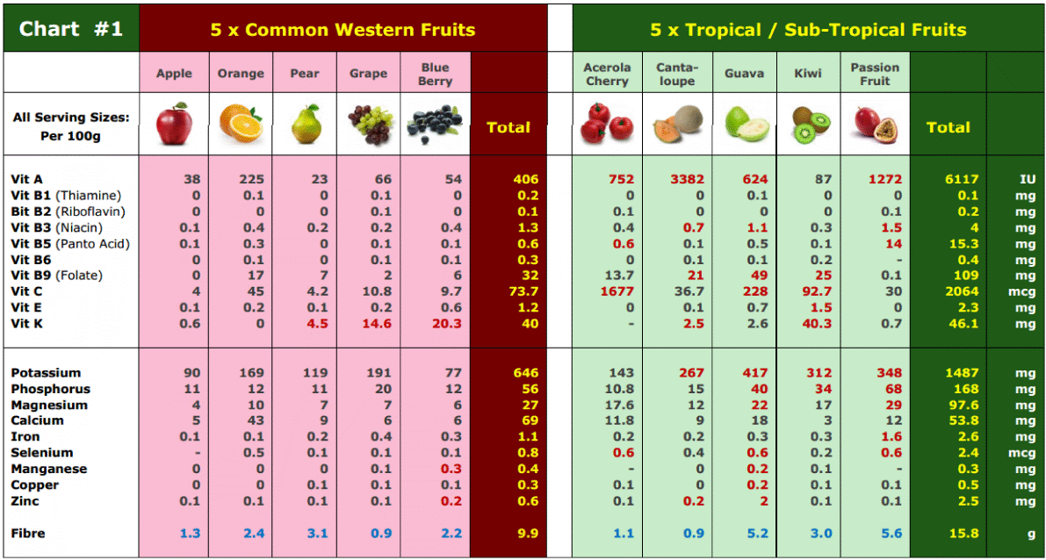

Slide 35
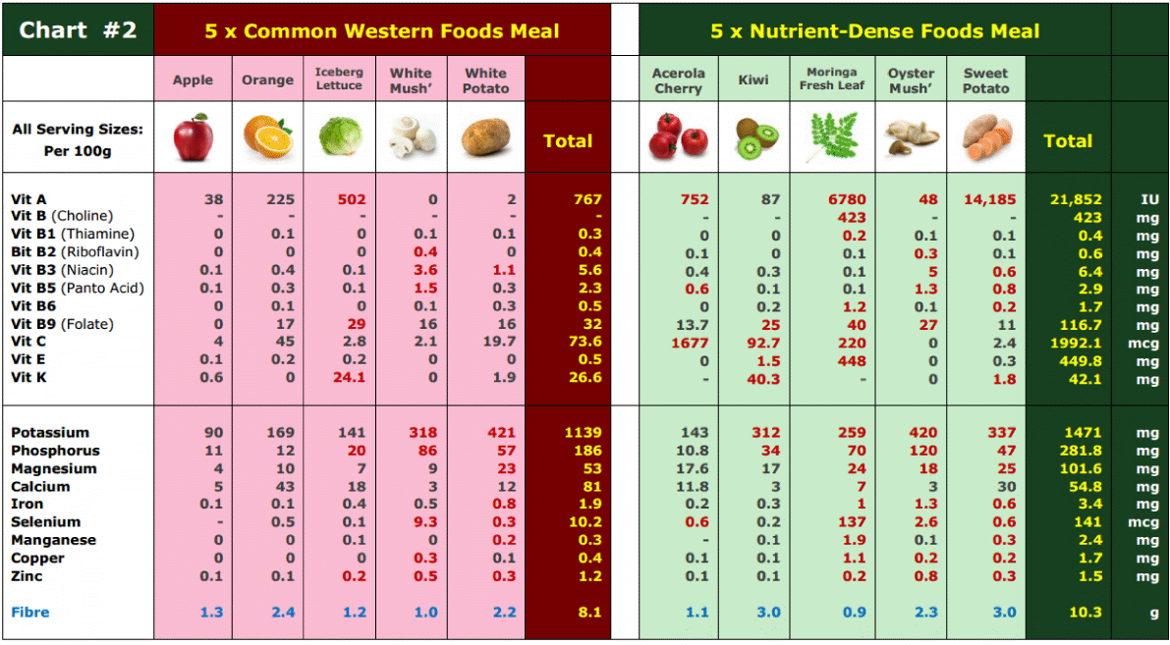

Slide 36
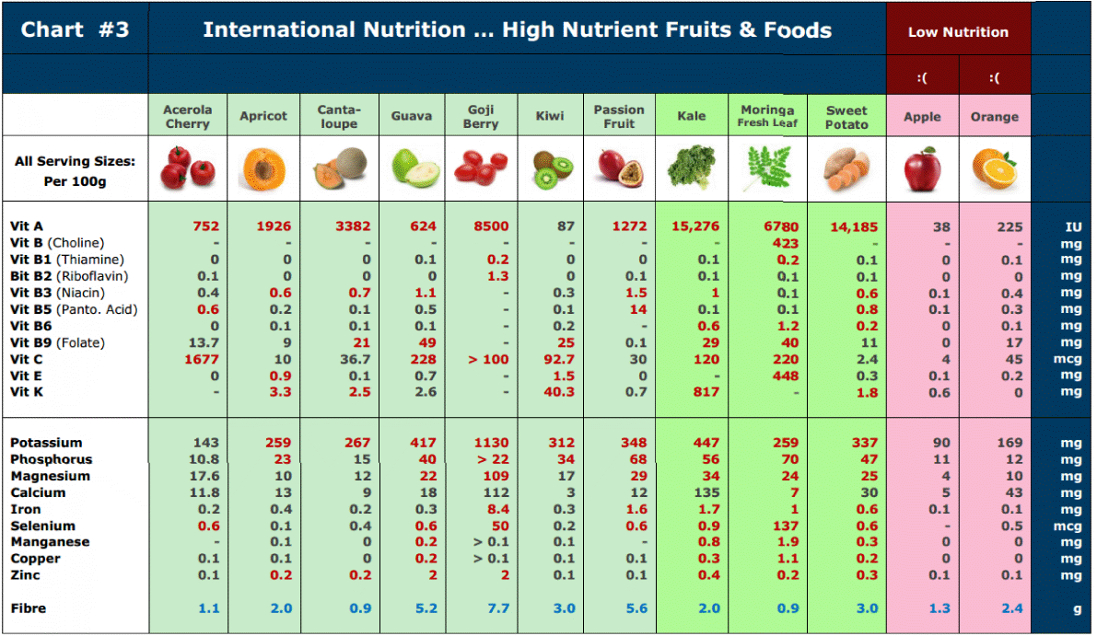

Slide 37
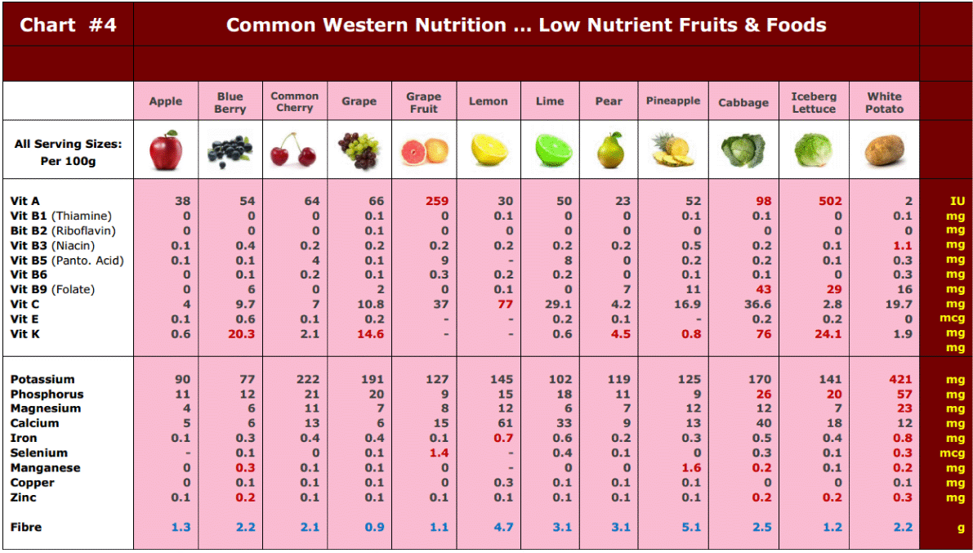

Slide 38
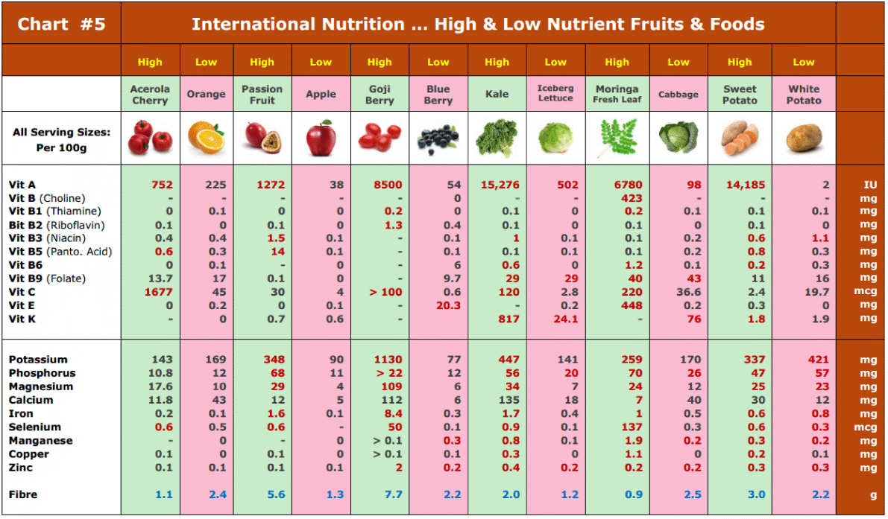

Slide 39
TMF Florida - Article
TMF Florida Quick Links:
http://tmfflorida.com/images_profiles_PDF/store_fruits_a_to_z_A4.pdf
http://tmfflorida.com/images_profiles_PDF/store_5_per_day.pdf
http://tmfflorida.com/images_profiles_PDF/store_moringa_A4.pdf
http://tmfflorida.com/commercial_info.html
http://tmfflorida.com/images_trade_info/TMF_presentation.pdf
http://tmfflorida.com/contact.html
Website: www.TMFflorida.com Email: TropicalMedicalFruits@gmail.com Tel: (+1) 561-792-5925 Skype: TMF.FLORIDA (English – Deutsch – Español)

Slide 40

TMF Florida … a Subsidiary of Arvila LLC
TMF Florida - Article
Website: www.TMFflorida.com Email: TropicalMedicalFruits@gmail.com Tel: (+1) 561-792-5925 Skype: TMF.FLORIDA (English – Deutsch – Español)

Slide 41


TMF Florida … a Subsidiary of Arvila LLC
TMF Florida - Article
Website: www.TMFflorida.com Email: TropicalMedicalFruits@gmail.com Tel: (+1) 561-792-5925 Skype: TMF.FLORIDA (English – Deutsch – Español)

